Slide 1
Advanced Database Management Systems (CSC-234)
MongoDB CRUD Operations

Slide 2
Interacting with cursors

Slide 3
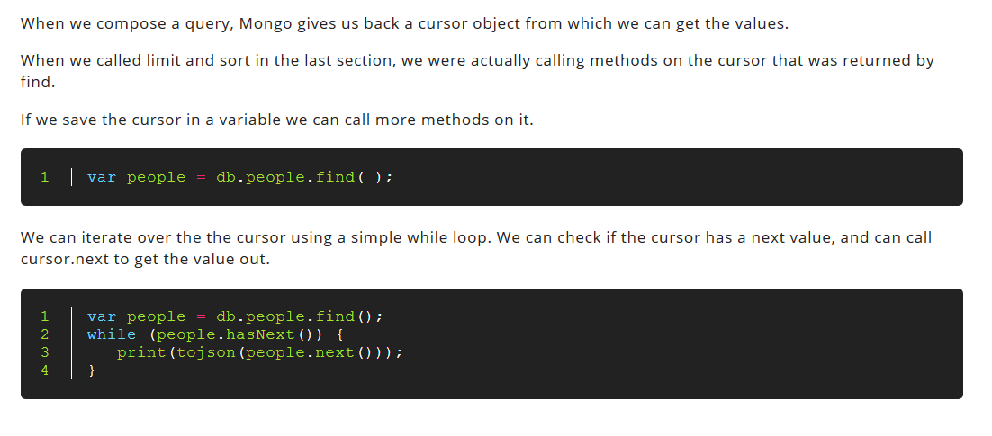

Slide 4
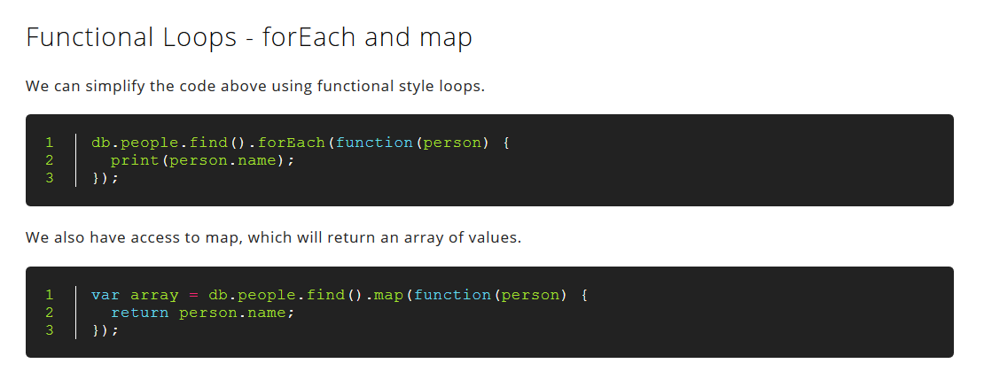

Slide 5
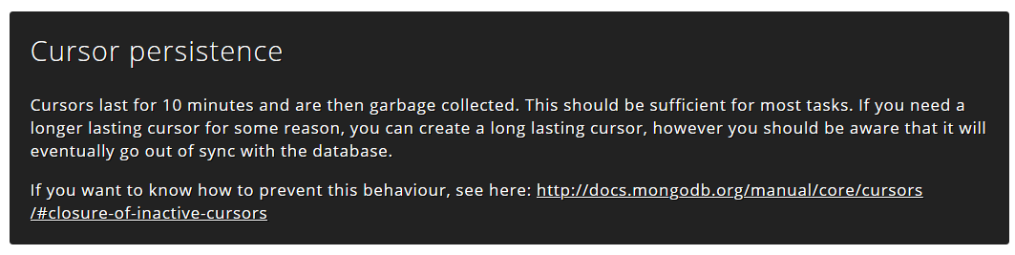

Slide 6
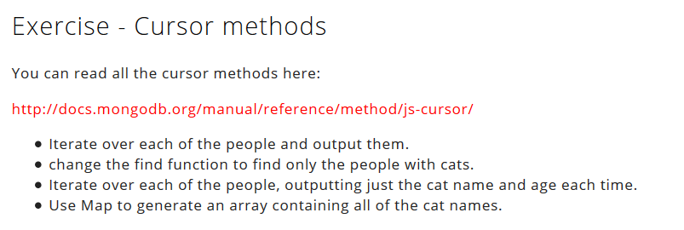
http://docs.mongodb.org/manual/reference/method/js-cursor/

Slide 7
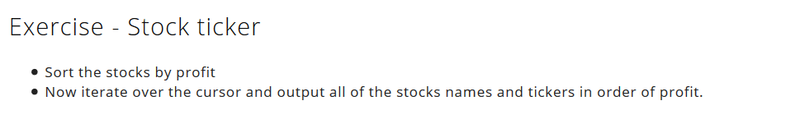

Slide 8
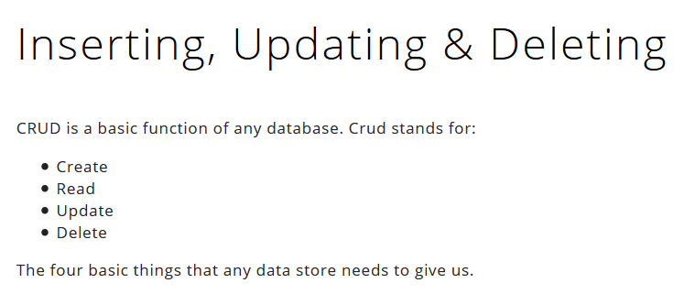

Slide 9
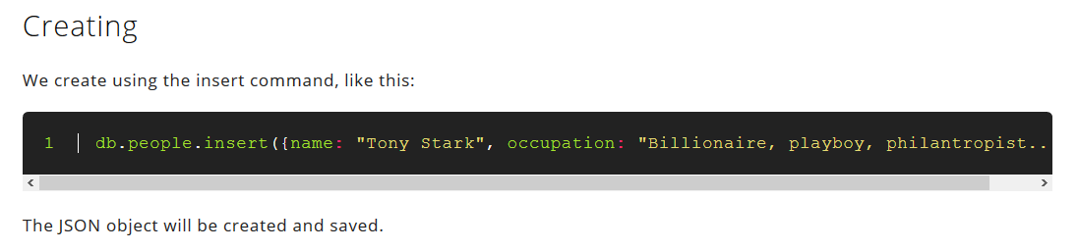

Slide 10
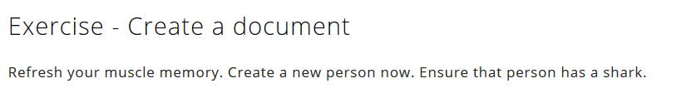

Slide 11
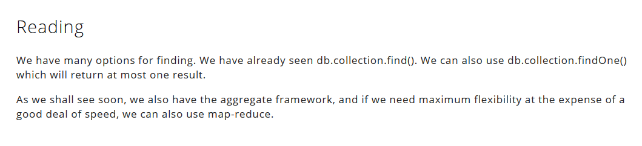

Slide 12
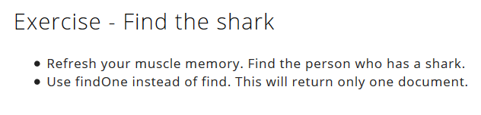

Slide 13
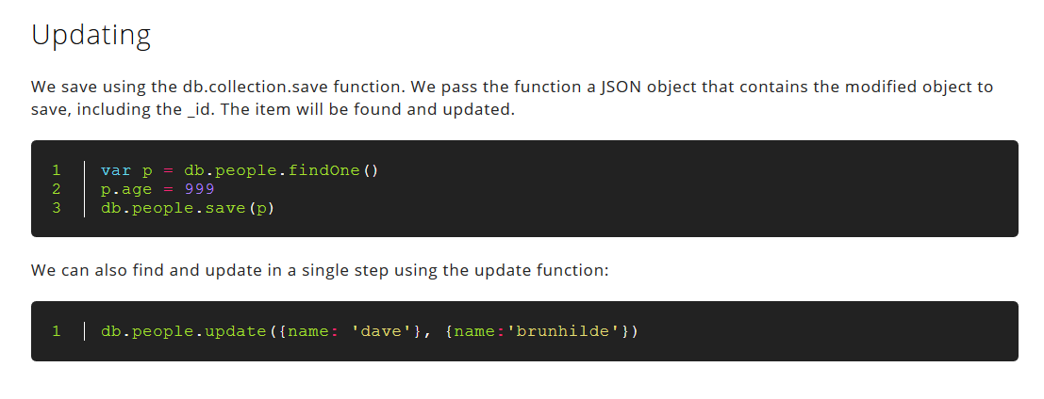

Slide 14


Slide 15
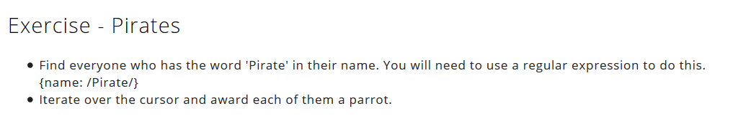

Slide 16
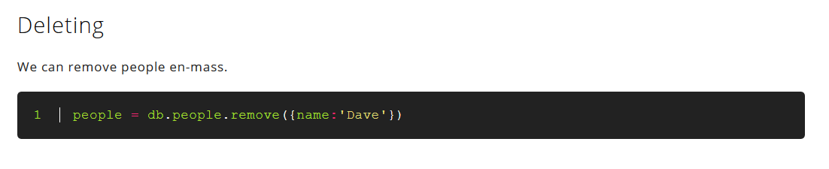

Slide 17
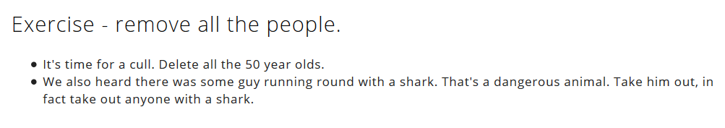

Slide 18
Lecture content adapted from https://docs.mongodb.com/manual/ & http://nicholasjohnson.com/mongo/course/workbook/

